Slide 1



Building Bayesian models: Why bother if you don’t believe?
Dan Cornford, Simon Bell
Aston University

Slide 2
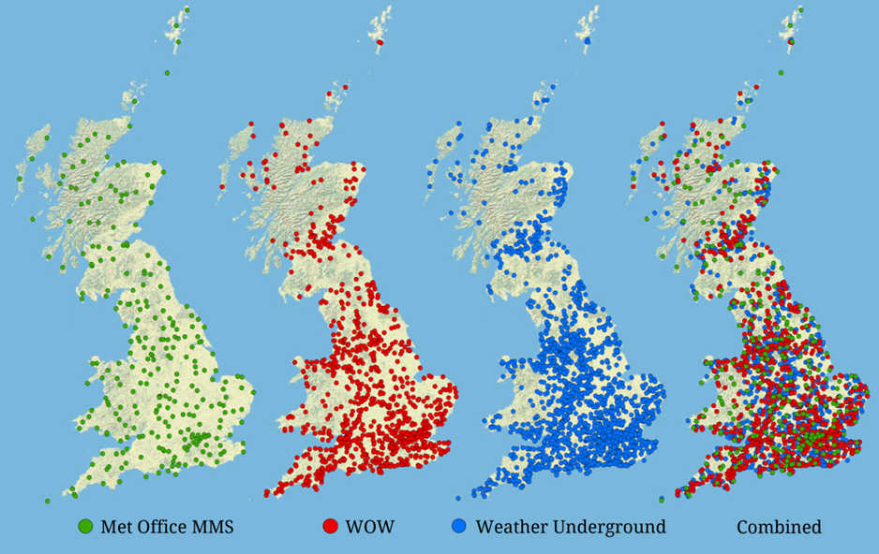
Spatial distribution of citizen weather stations

Slide 3
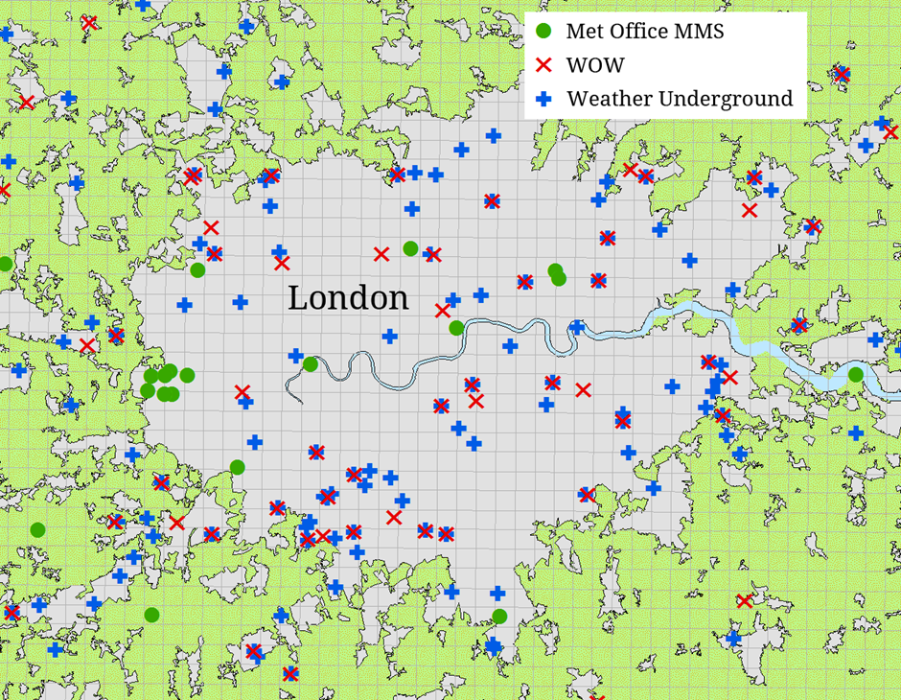
In more detail …

Slide 4
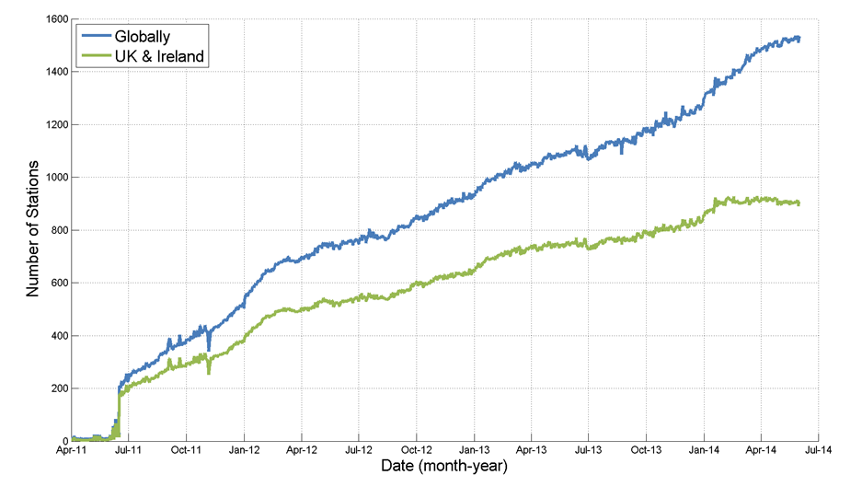
Growth of citizen weather data

Slide 5
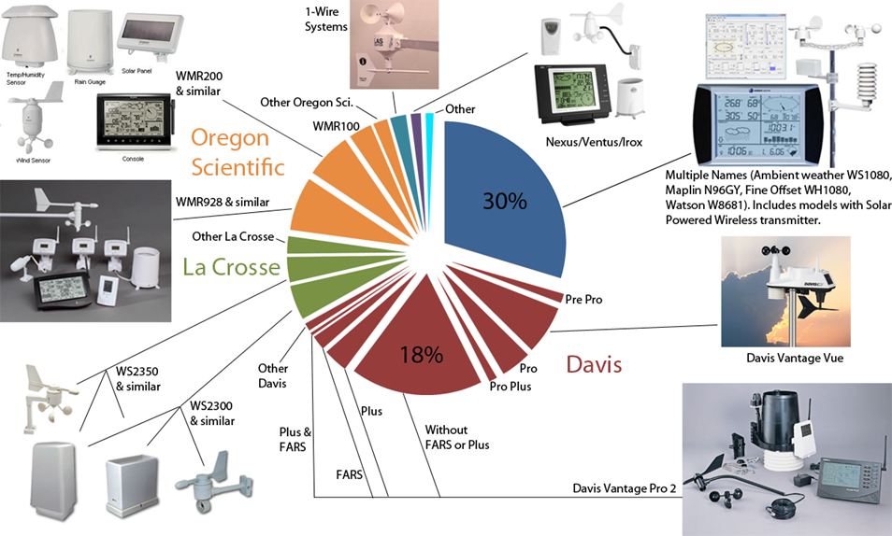
Types of stations

Slide 7
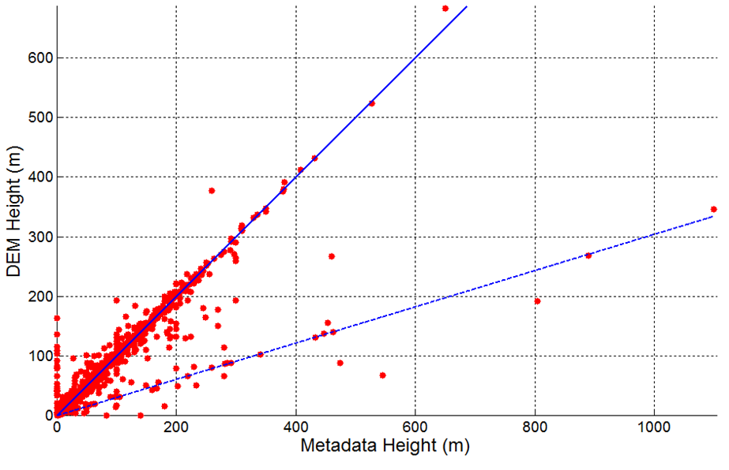
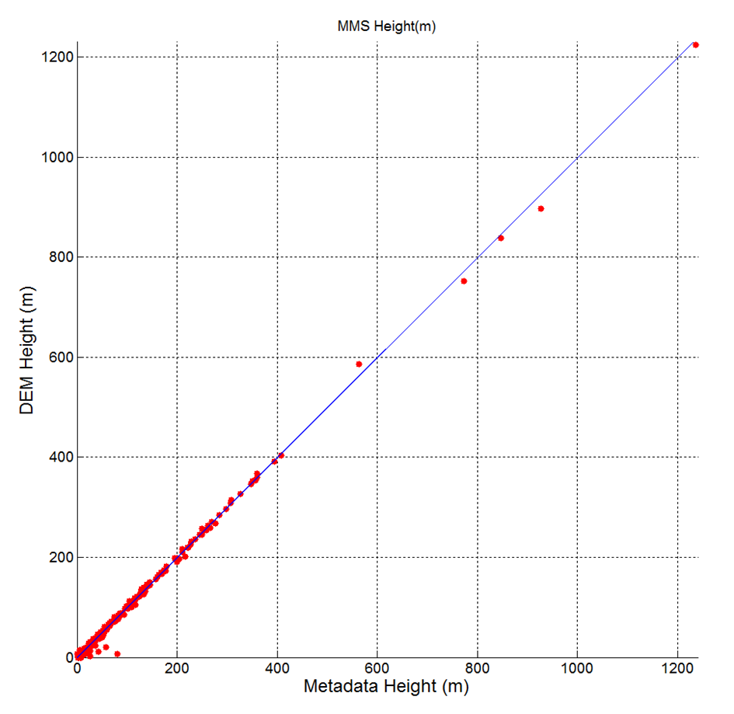
Data quality issues

Slide 8
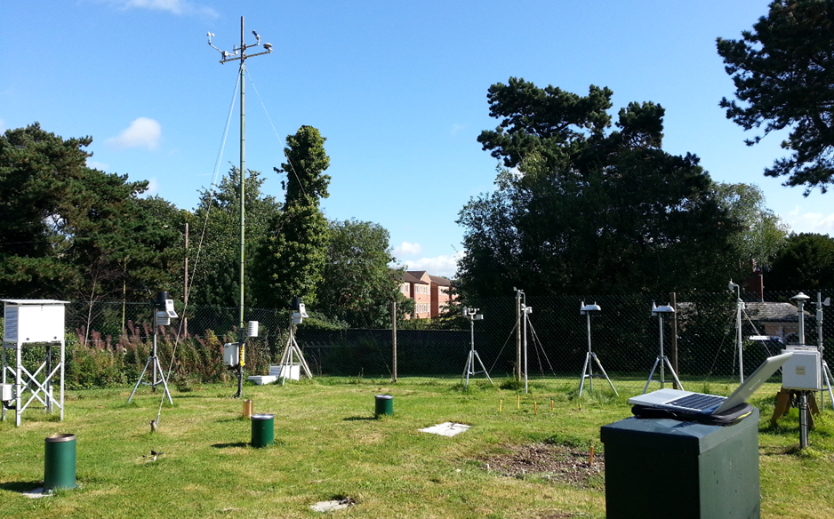
Assessing station quality

Slide 9
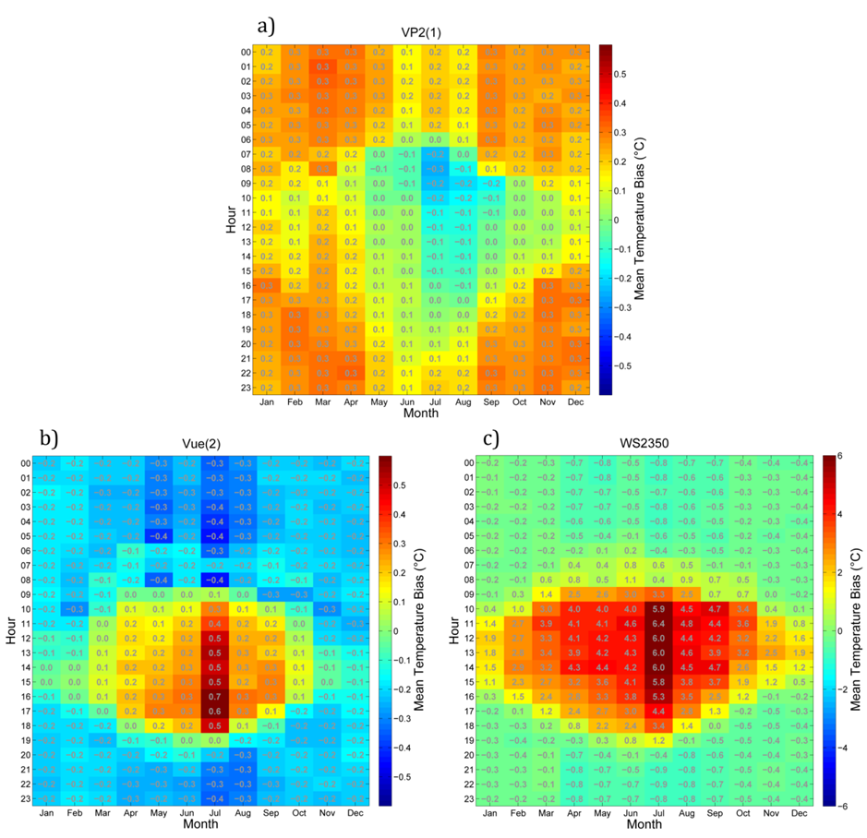
That is totally biased

Slide 10
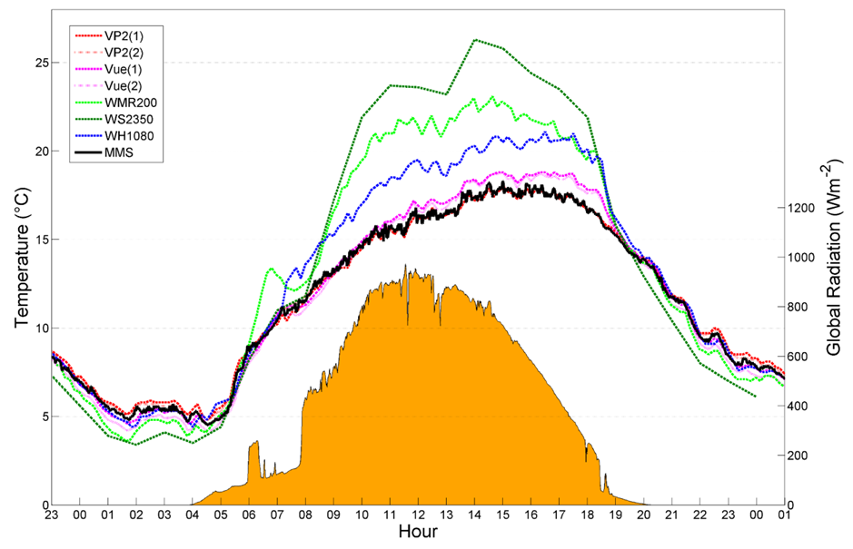
Exploring why – the role of physics and graphics

Slide 11
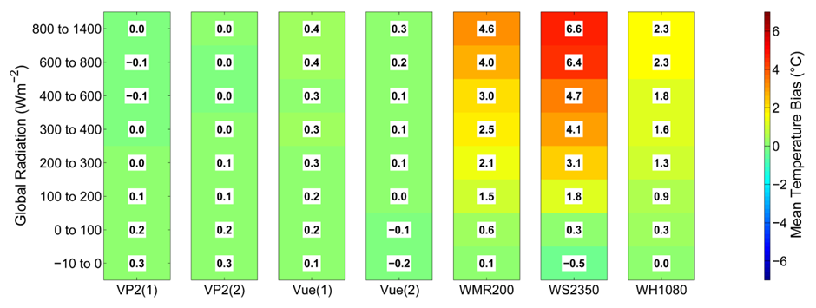
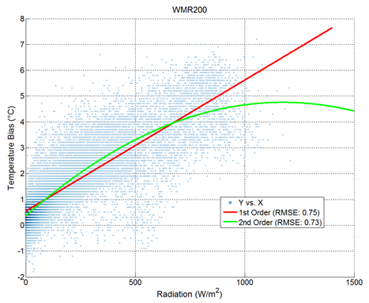
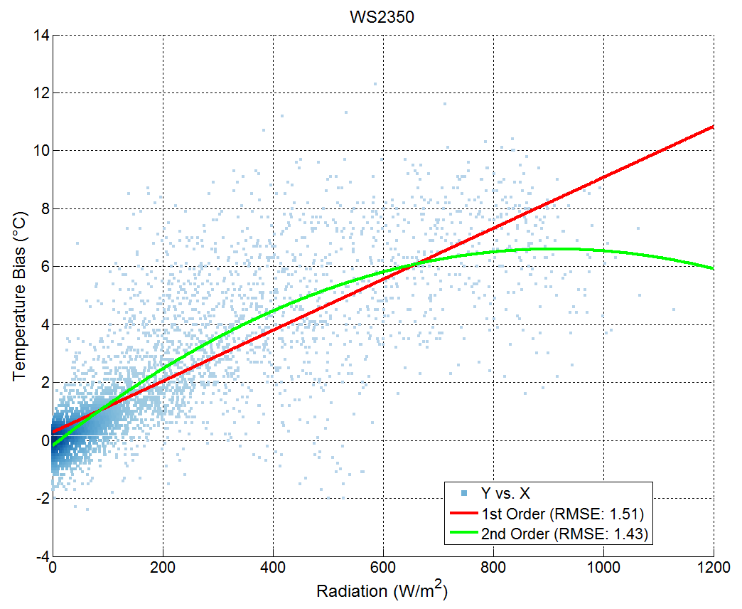
Building a model

Slide 12
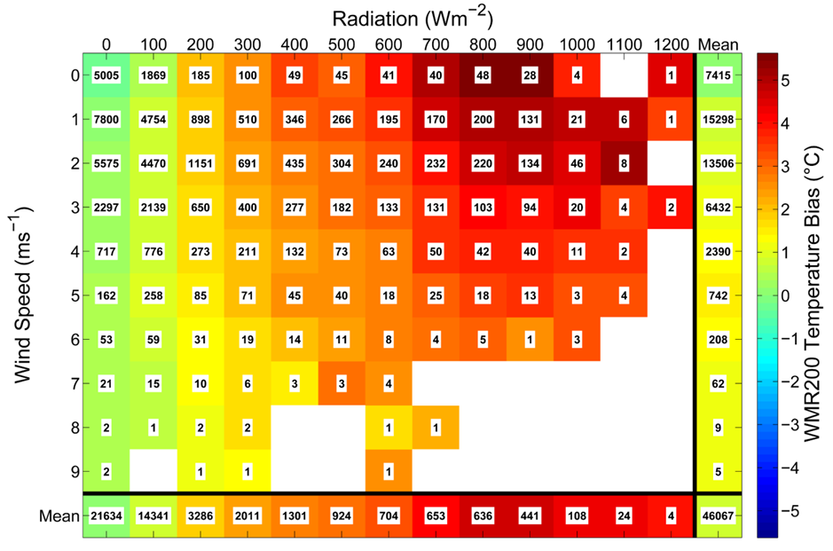
Other explanations?

Slide 13
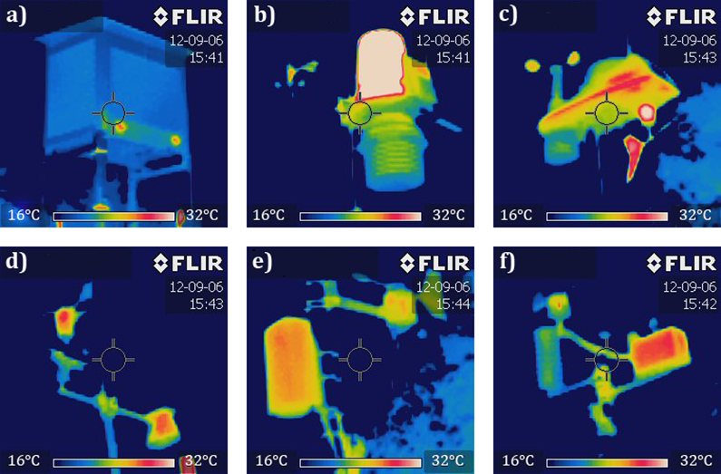
Confirmation – a mechanism

Slide 14
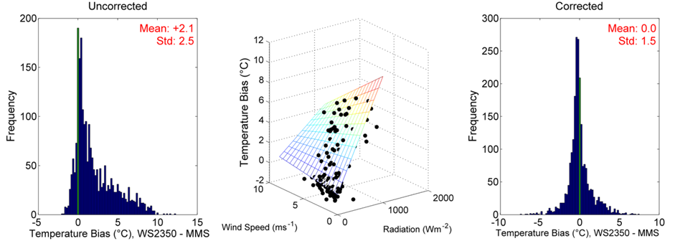
Simple models can go a long way

Slide 15
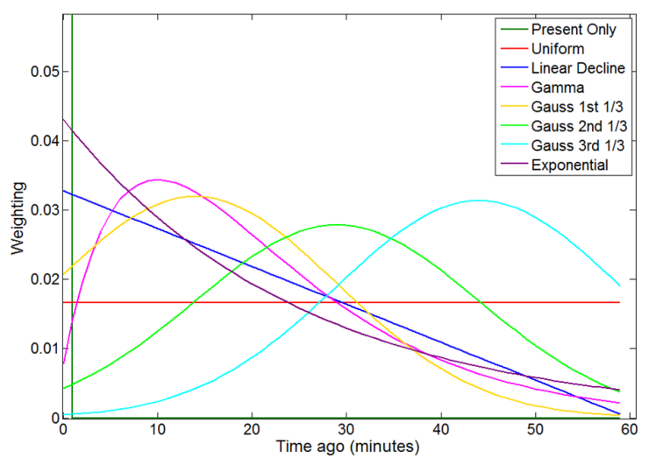
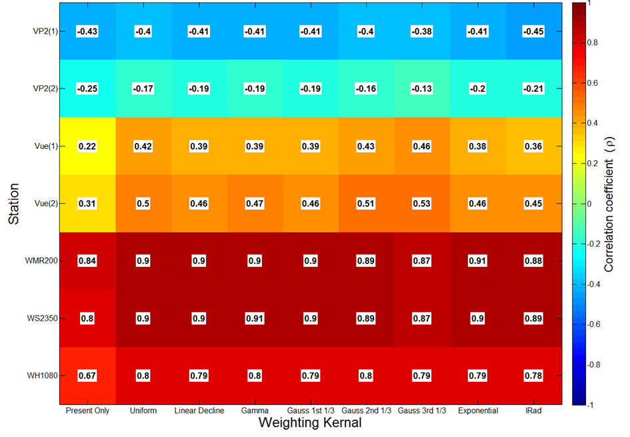
Marginal improvements, better physics?

Slide 16
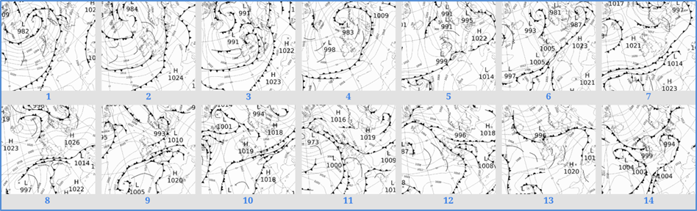
What is a case study?

Slide 17
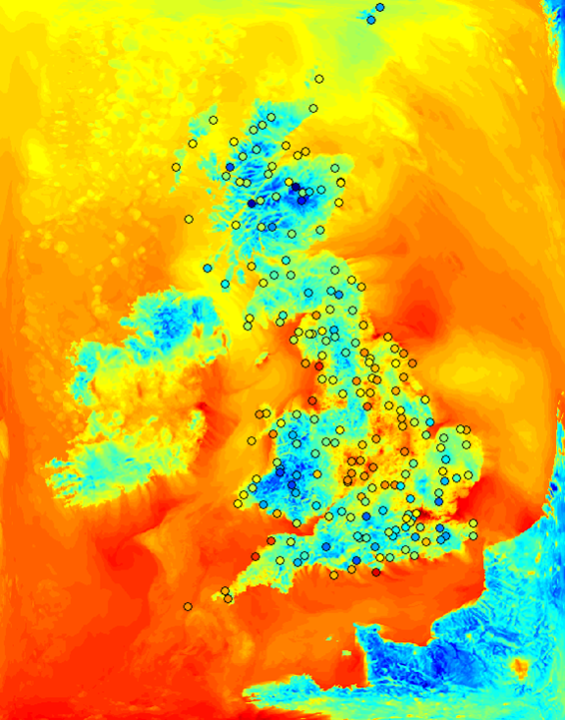
Really complex priors …

Slide 18
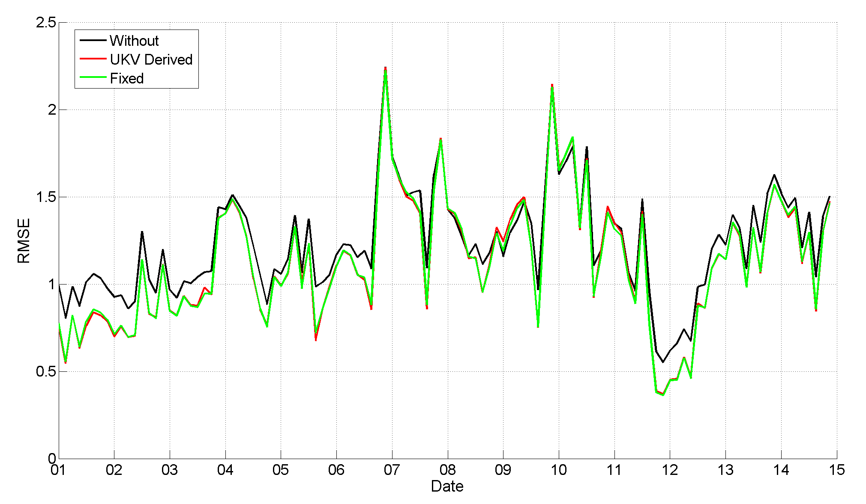
Simple corrections can help

Slide 19
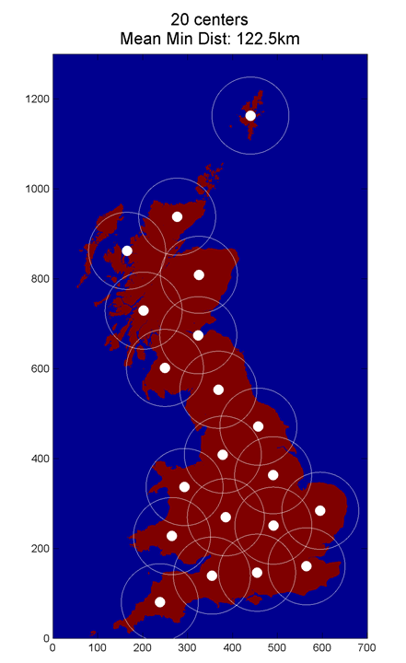
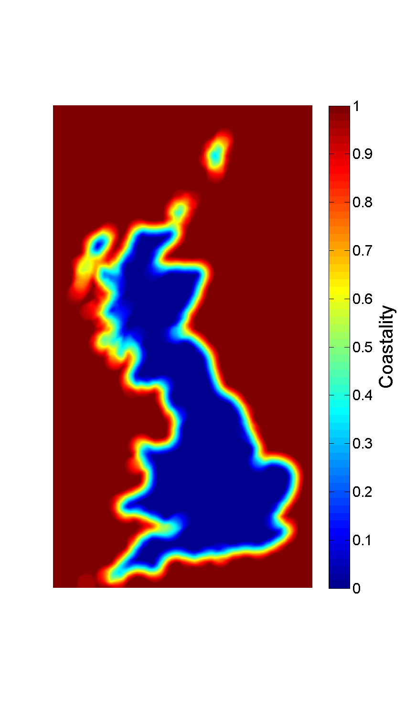
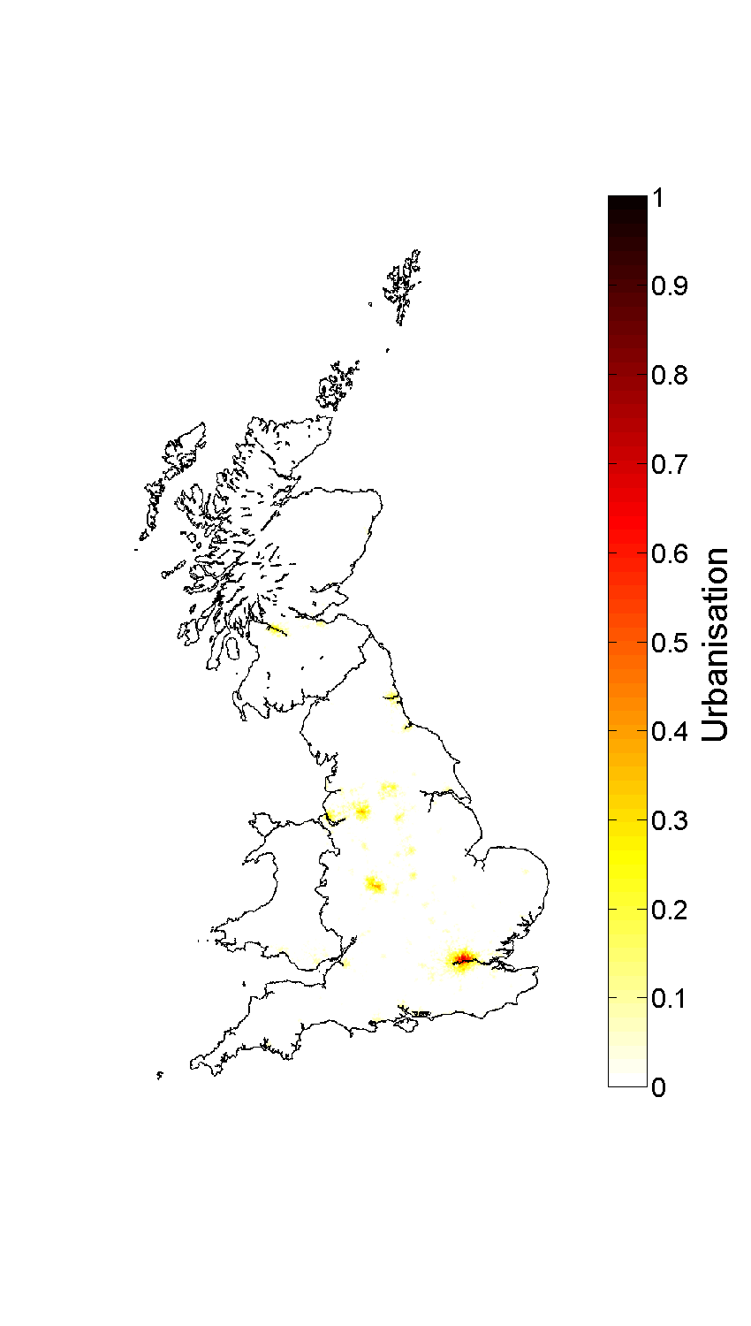
Select your inputs carefully …

Slide 20
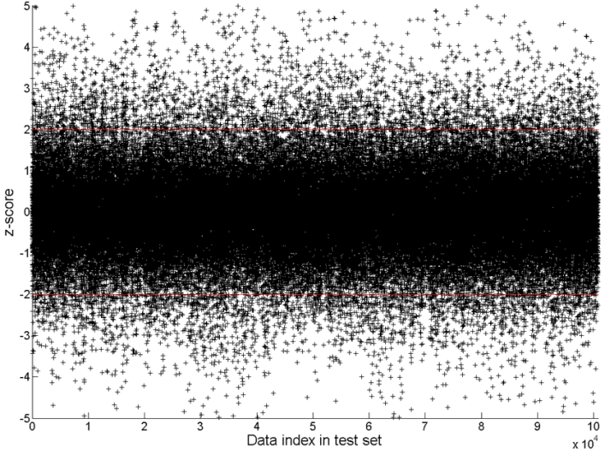
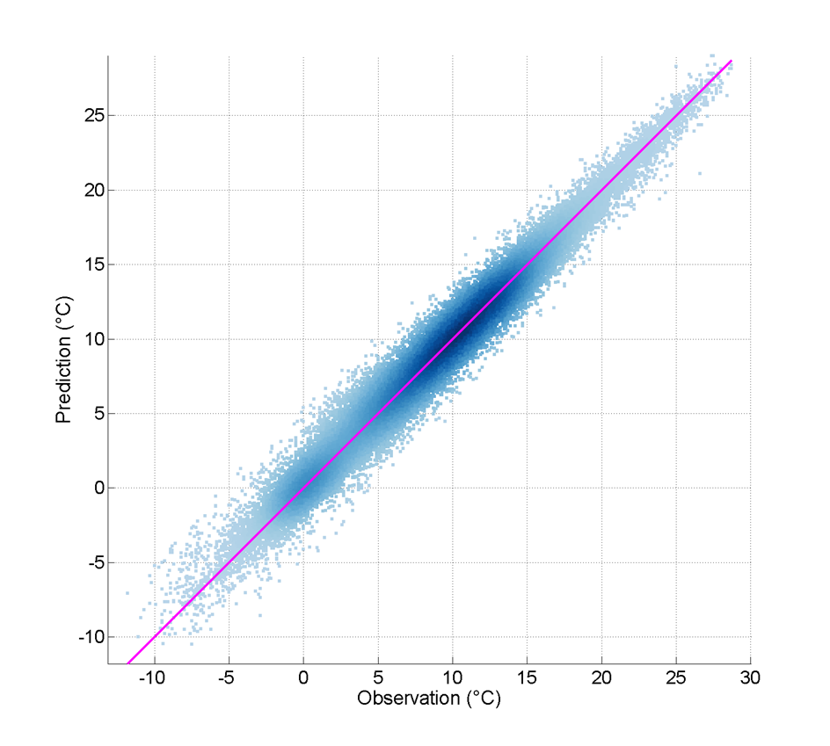
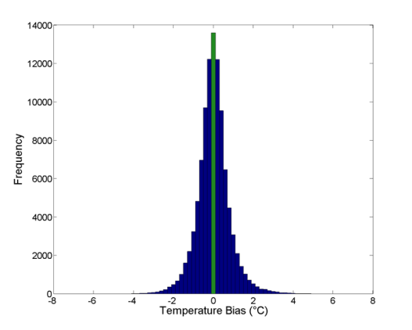
And validate

Slide 21
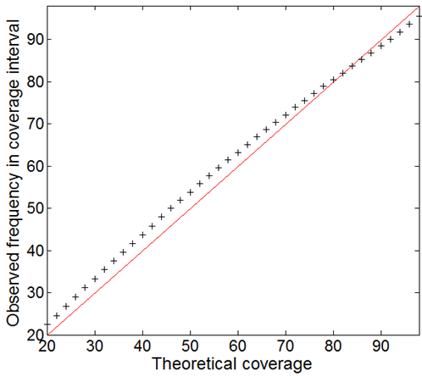
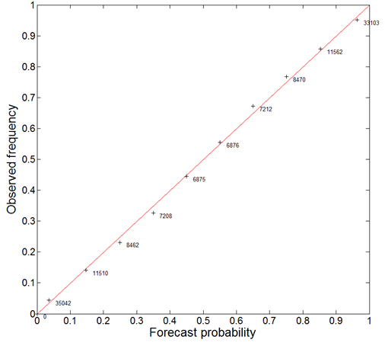
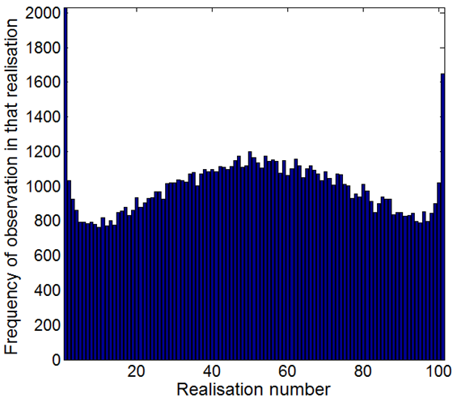
Carefully …

Slide 22
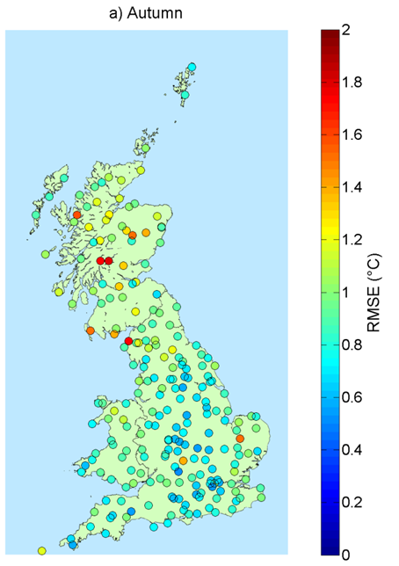
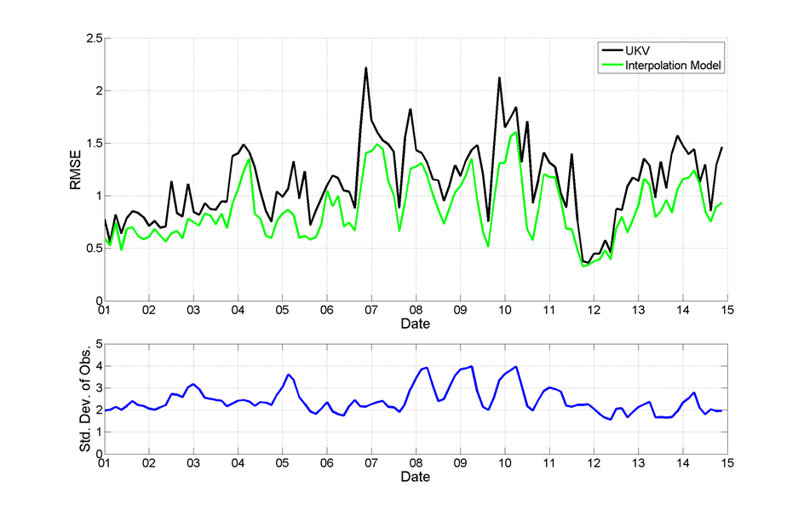
Sir Plotalot

Slide 23
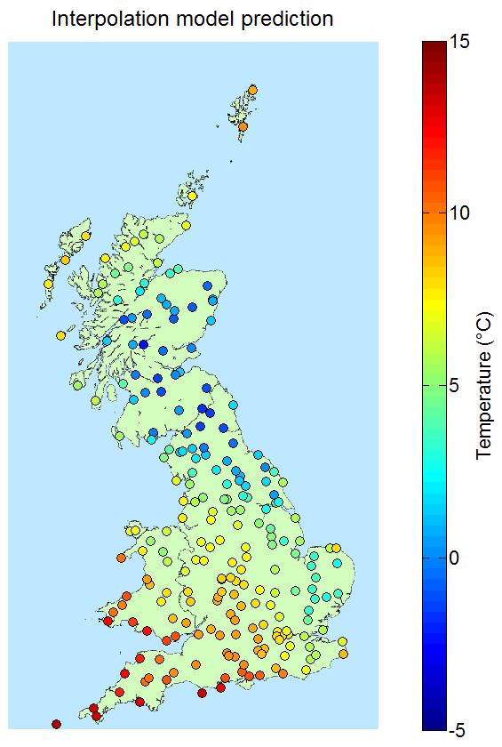
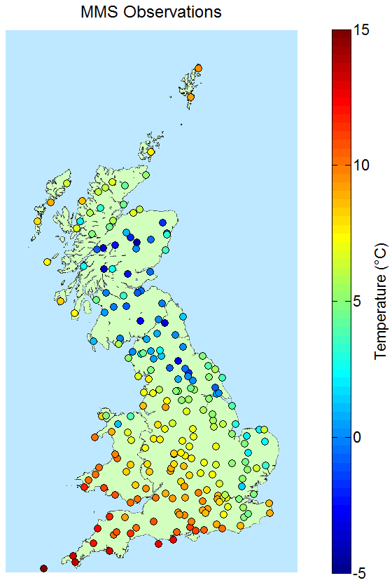
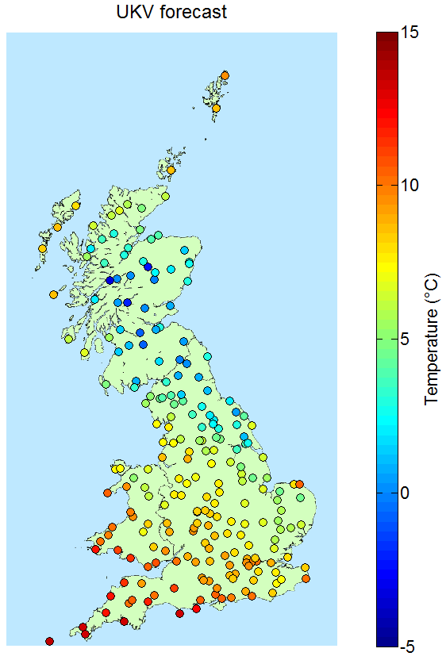
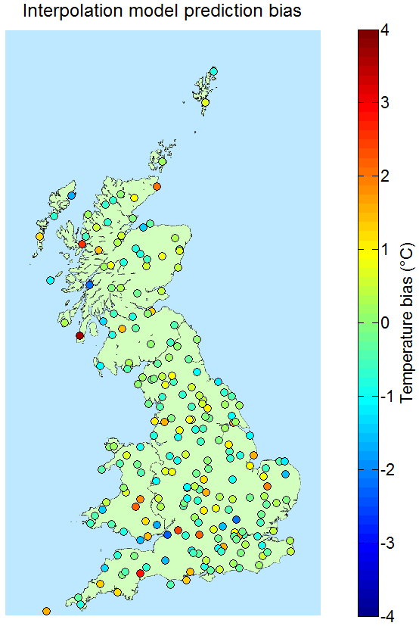
Seriously …

Slide 24
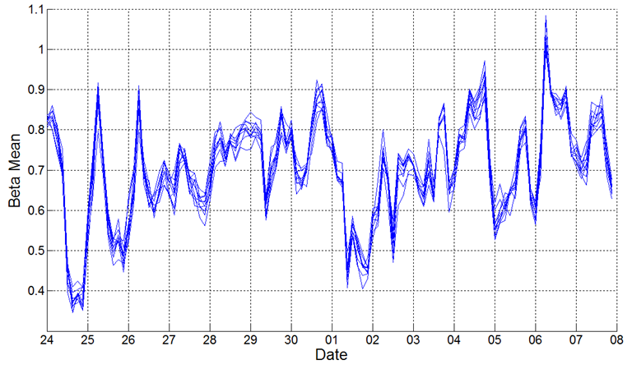
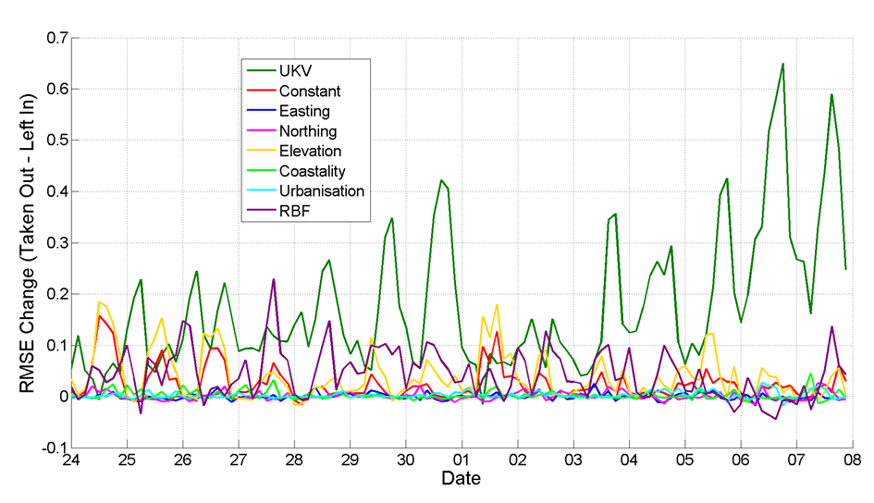
Understanding your model

Slide 25
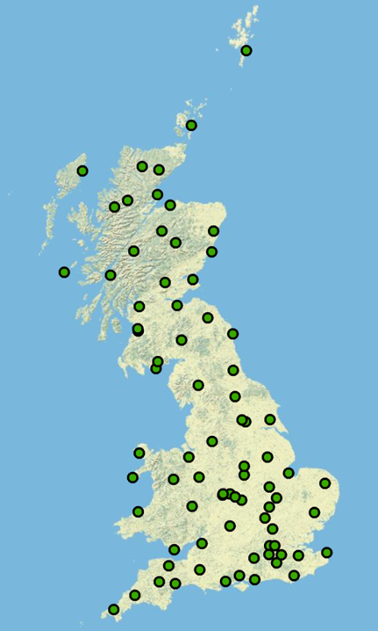
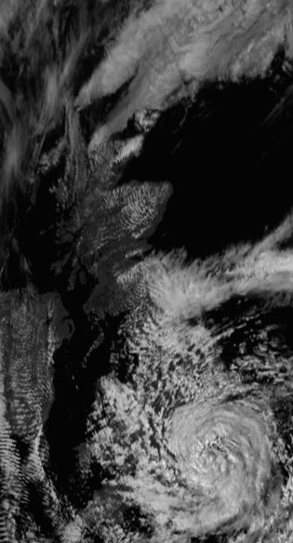
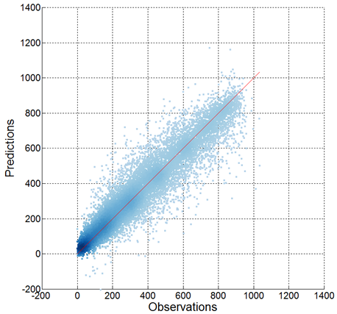
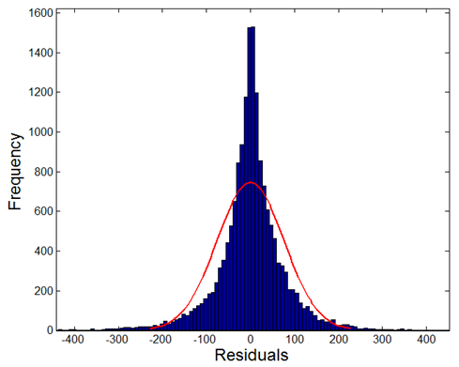
Using your knowledge is never easy
Notes:
Stations with radiation measurements …

Slide 26
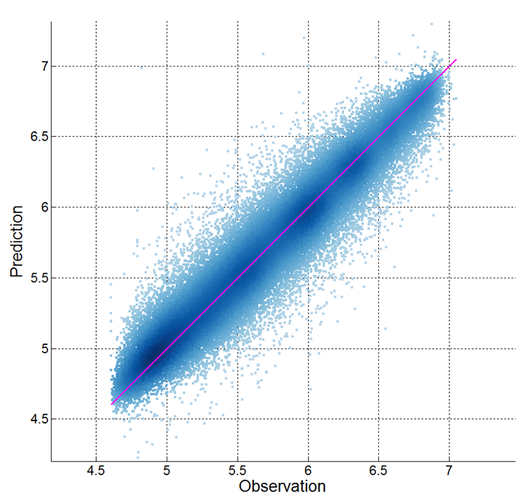
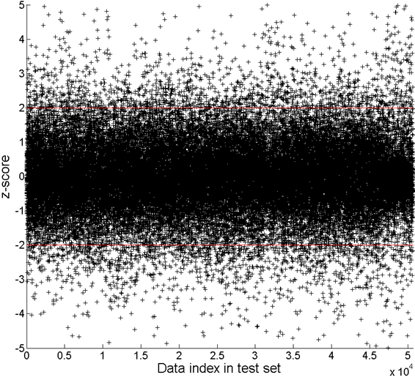
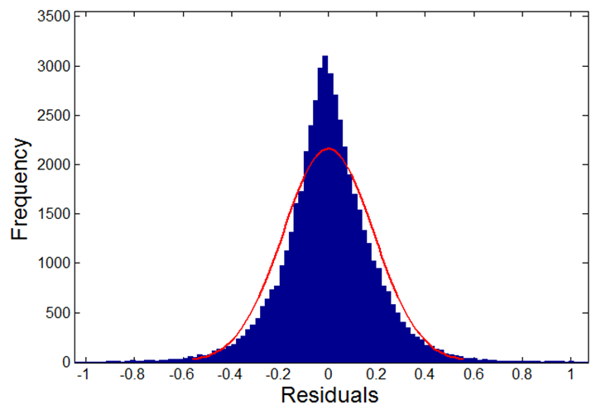
But always look for simple solutions

Slide 27

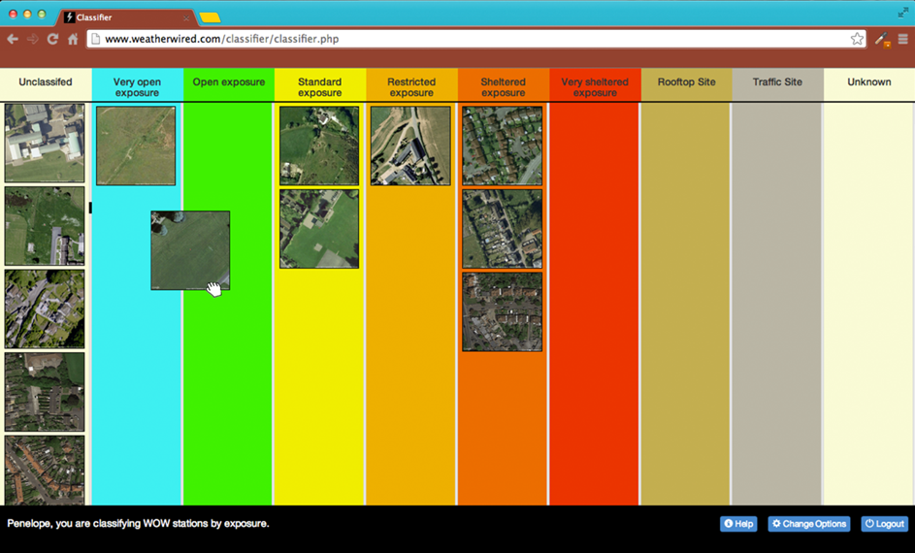
Ask the public …

Slide 29
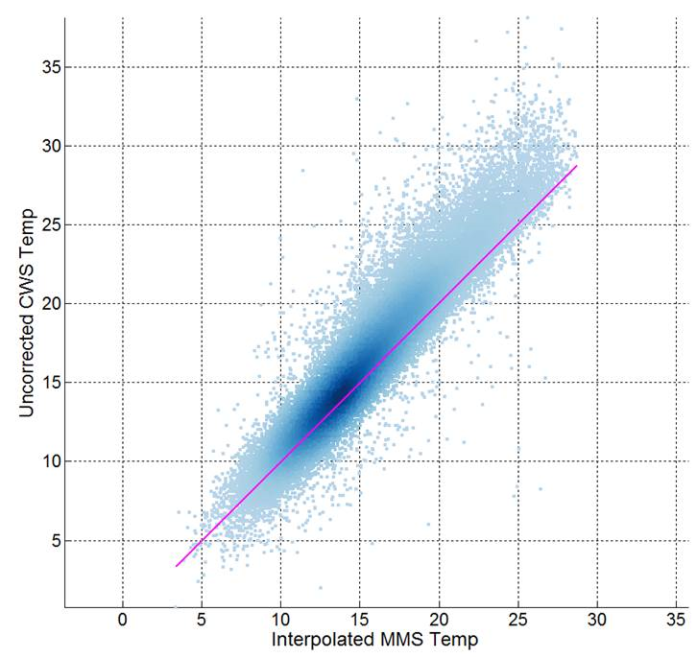
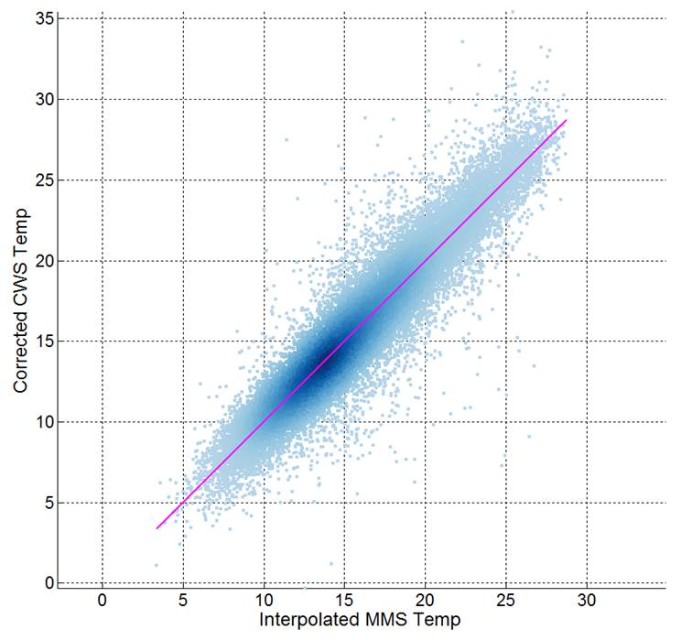
You can fixing things

Slide 30
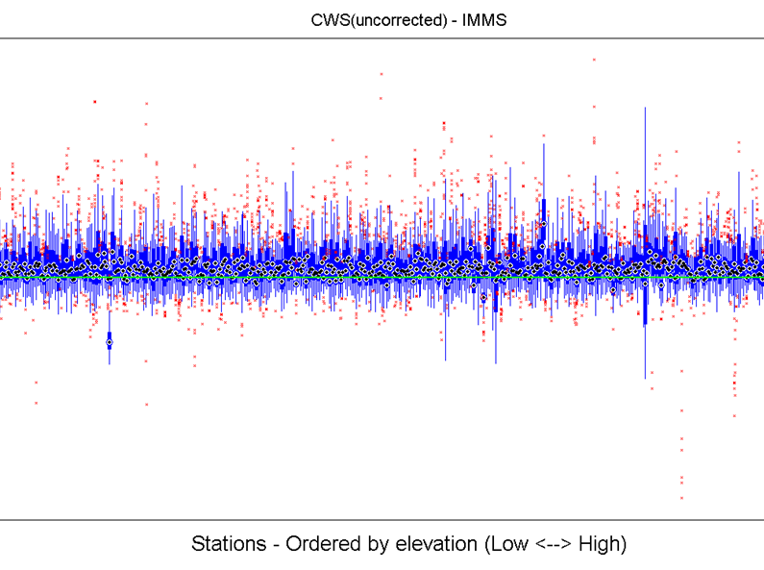
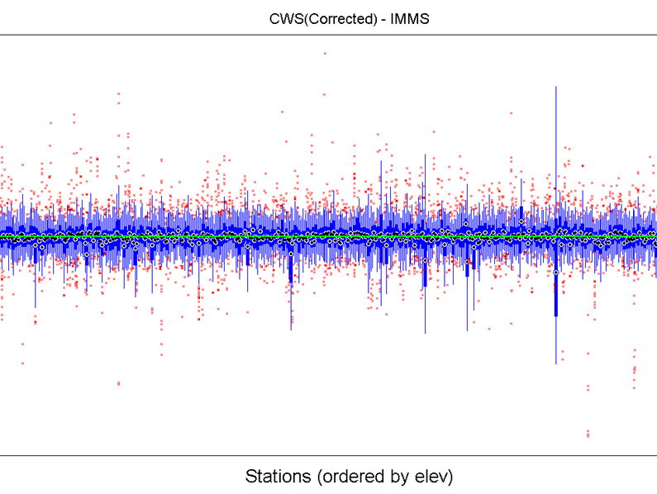
To an extent

Slide 31
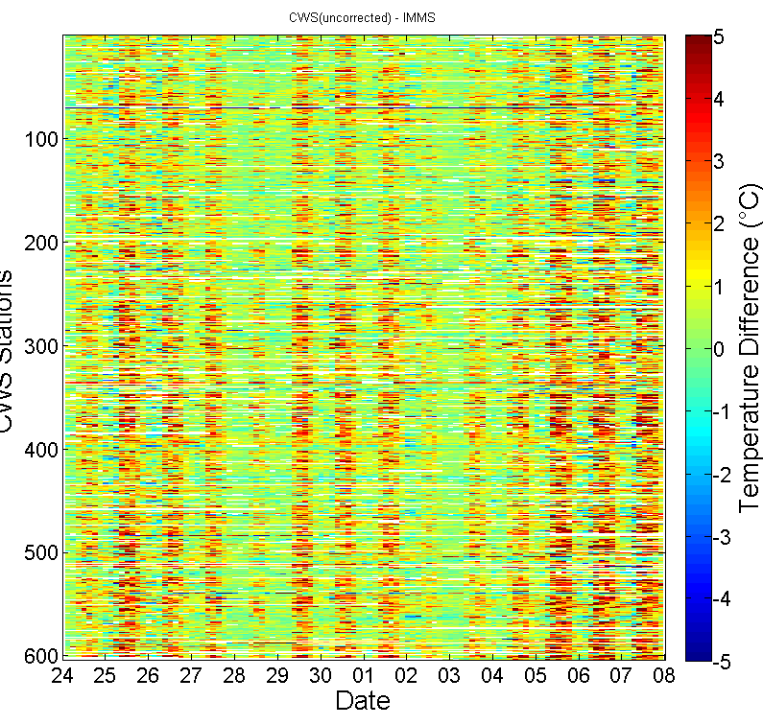

Fixing everything is not going to happen

Slide 32

Do all the hard work and …

Slide 33

But we can learn a lot

Slide 34

Mitigating some ‘nasty’ issues

Slide 35


Or simply confirm what we see

Slide 36


Even for the ‘best’ stations

Slide 37

Simple models, but significant insight

Slide 38
Summary
Don’t try and do a purely graphical talk!
Be clear on your aims …
Validate probabilistic models probabilistically
if you care!
Be prepared to spend 80% of your time exploring the mess that is your data
I’d strongly prefer simple (and fast to run) models
allows prior sensitivity, model exploration and cross validation (without waiting)
Be clear what is ‘good enough’
your model will never be perfect on real data – remember it is a model
I’ve never seen real data that actually comes from a Gaussian process
Thanks!

